Slide 1
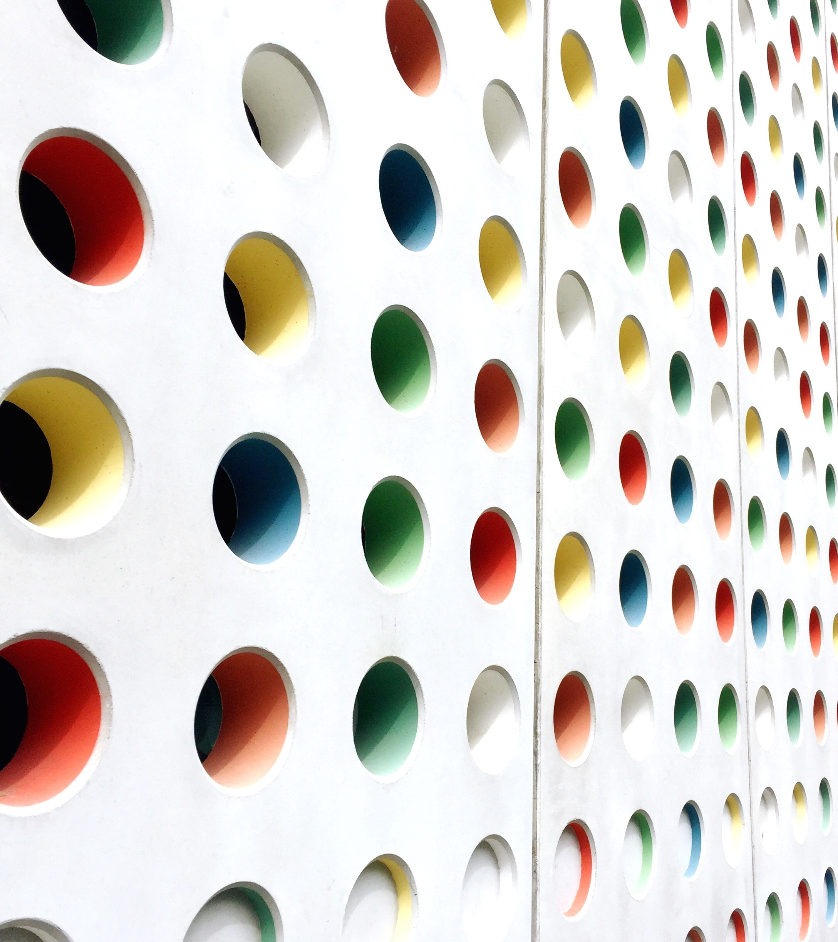
StyleTransfer
U of T SCS3546-DEEP LeARNING
Aug 2020 - Tony Sinn
tony.sinn@mail.utoronto.ca

Slide 2
Style Transfer
Neural style transfer (NST) is a computer vision technique that takes two images – a
content image and a style reference image – and blends them together so that the
resulting output image retains the core elements of the content image but appears to be
painted in the style of the style reference image. The output image from a NST network
is called a pastiche. A pastiche is a work of visual art, literature, theater or music that
imitates the style (or character) of the work of one or more other artists. Unlike a parody,
a pastiche celebrates rather than mocks the work it imitates.
University of Toronto – SCS 3546 DEEP LEARNING

Slide 3
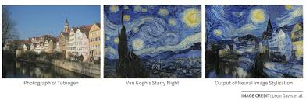
Style Transfer
Content Image
Style Image
Stylized Image
University of Toronto – SCS 3546 DEEP LEARNING

Slide 4
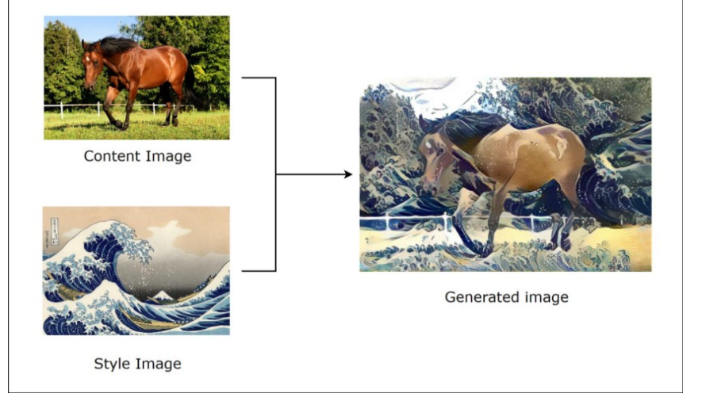
Style Transfer
Content Image
Style Image
Stylized Image
University of Toronto – SCS 3546 DEEP LEARNING

Slide 5
Style Transfer
ARBITRARY STYLE TRANSFEr
Style Transfer – TENSORFLOW LITE
NEURAL Style Transfer
University of Toronto – SCS 3546 DEEP LEARNING

Slide 6
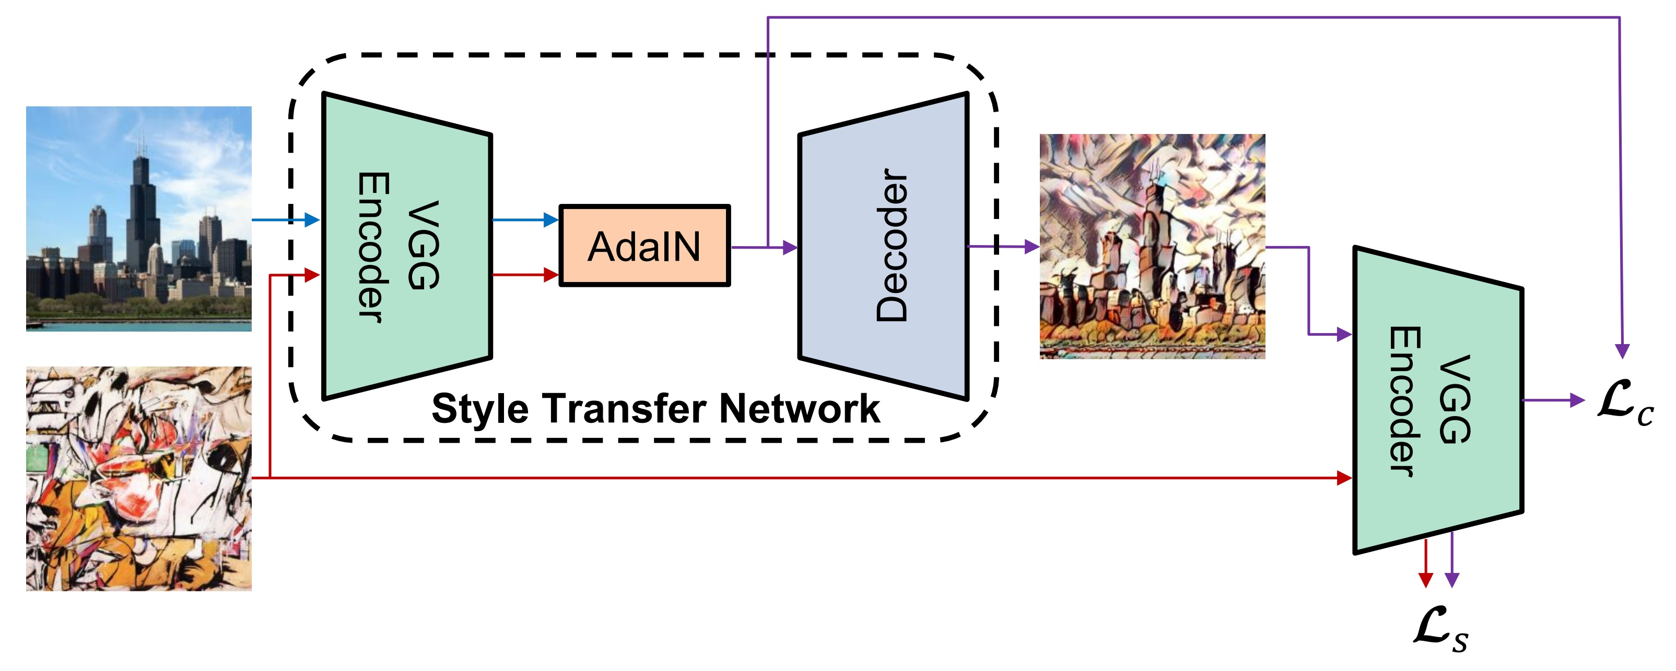
Style Transfer – Arbitrary Style Transfer https://tfhub.dev/google/magenta/arbitrary-image-stylization-v1-256/2
https://github.com/xunhuang1995/AdaIN-style
Arbitrary Style Transfer in Real-time with Adaptive Instance Normalization
University of Toronto – SCS 3546 DEEP LEARNING

Slide 7
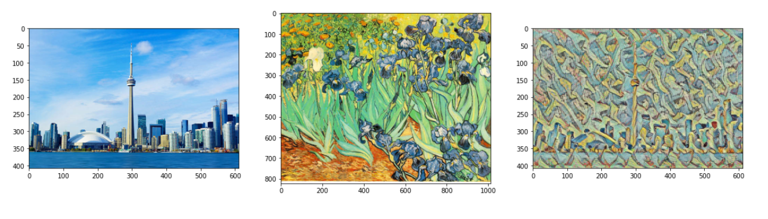
Style Transfer – Arbitary Style Transfer
University of Toronto – SCS 3546 DEEP LEARNING

Slide 8
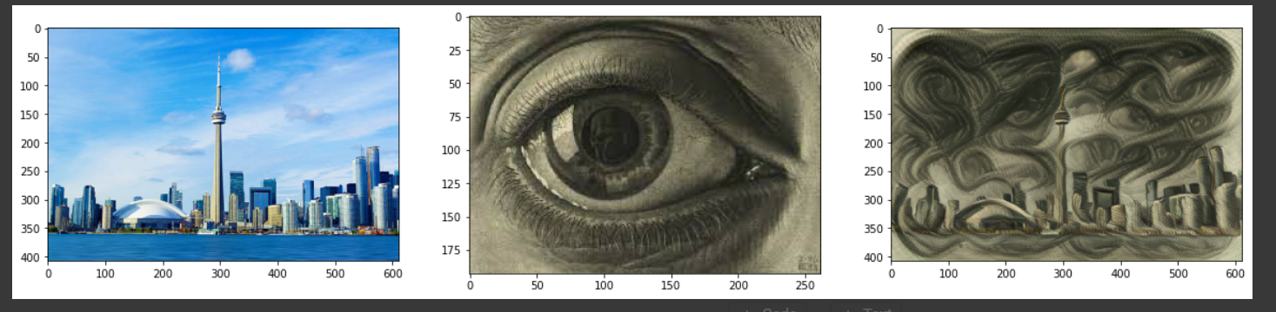
Style Transfer – Arbitrary Style Transfer
https://github.com/xunhuang1995/AdaIN-style
University of Toronto – SCS 3546 DEEP LEARNING

Slide 9
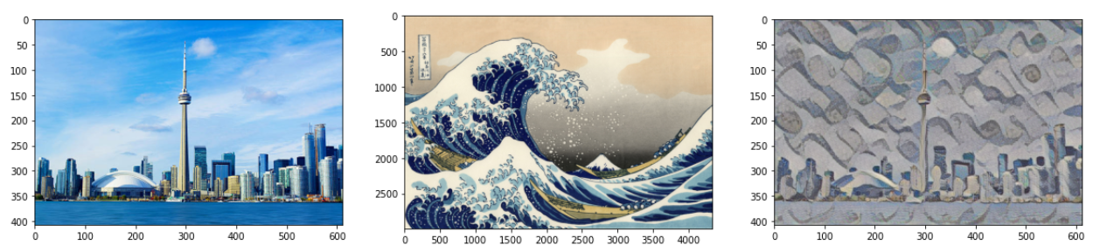
Style Transfer – Arbitrary Style Transfer
University of Toronto – SCS 3546 DEEP LEARNING

Slide 10
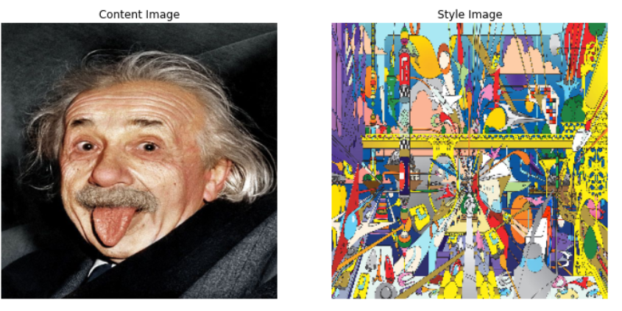
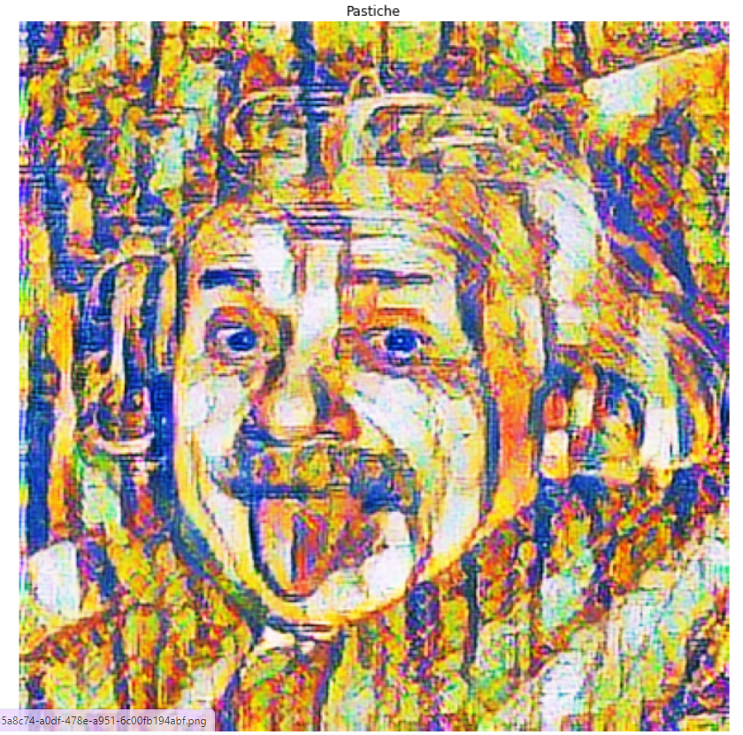
Style Transfer – Tensorflow Lite
University of Toronto – SCS 3546 DEEP LEARNING

Slide 11
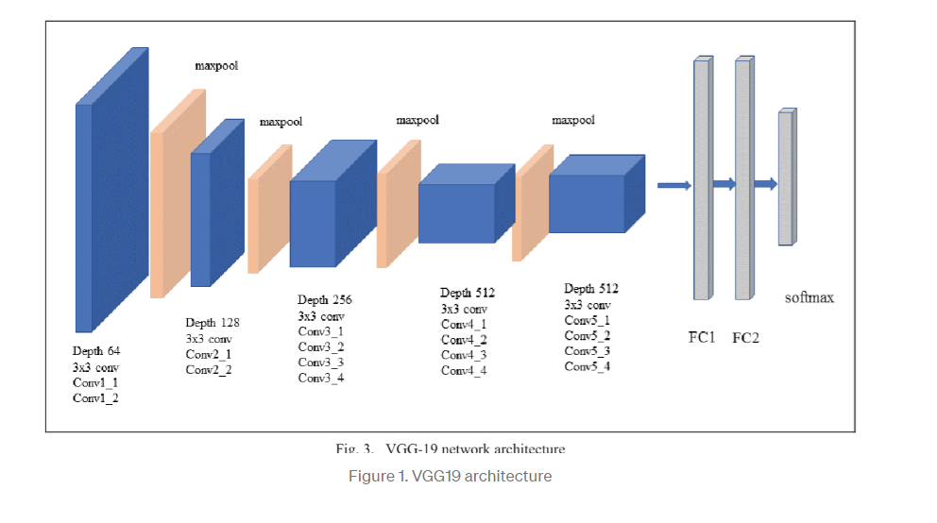
Style Transfer – VGG19 using Transfer Learning
Separating Style and Content
Style transfer relies on separating the content and style of an image. Given one content image and one style image, we aim to create a new, target image which should contain our desired content and style components:
University of Toronto – SCS 3546 DEEP LEARNING

Slide 12
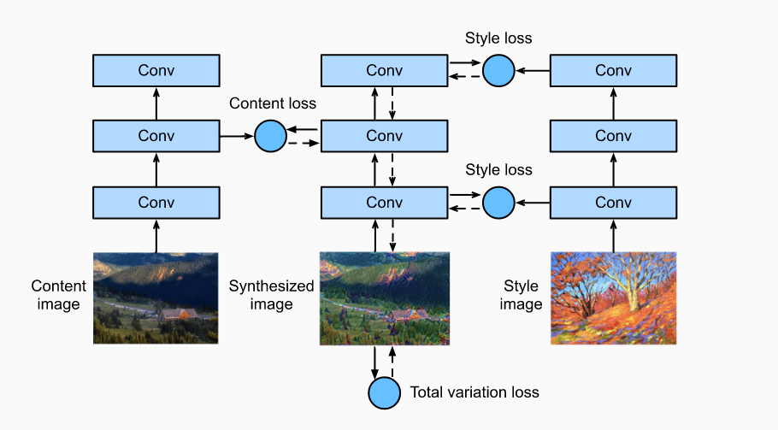
Style Transfer – VGG19 using Transfer Learning – Loss Functions
University of Toronto – SCS 3546 DEEP LEARNING

Slide 13
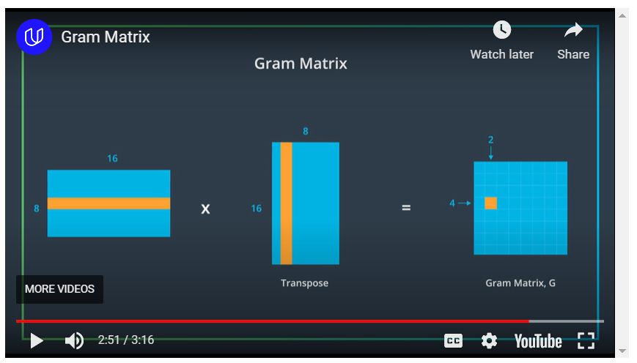
Style Transfer – VGG19 using Transfer Learning – Gram Matrix
https://youtu.be/e718uVAW3KU
University of Toronto – SCS 3546 DEEP LEARNING

Slide 14
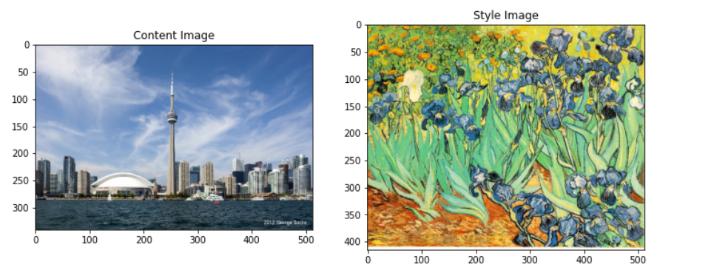
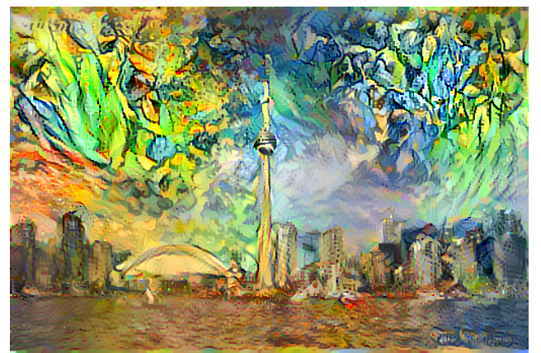
Style Transfer – VGG19 using Transfer Learning
University of Toronto – SCS 3546 DEEP LEARNING

Slide 15
Lesson Learned
1. Neural Style Transfer using VGG19 and Transfer Learning – It takes a lot of time to train the model and get the stylized image but you can have better control on the features you may want to emphasis. (E.g. Texture, contrast or color)
2. With Arbitrary Style Transfer the stylized images got generated very fast style. Whether the style is Escher, Van Gogh and Monet.
3.With Tensor flow lite model the model can be load on the device to generate image.
4.In the future we can try style transfer for video using the Arbitrary Style Transfer
University of Toronto – SCS 3546 DEEP LEARNING

Slide 16
Resources https://github.com/eziat2/Style_Transfer/blob/main/README.md
https://www.christies.com/features/A-collaboration-between-two-artists-one-human-one-a-machine-9332-1.aspx
https://www.fritz.ai/style-transfer/#part-uses
https://arxiv.org/pdf/1703.06868.pdf
https://colab.research.google.com/drive/1amO7FjN_qE0KdvSyF_gamrwDYCiCTpTa
https://www.tensorflow.org/hub/tutorials/tf2_arbitrary_image_stylization
https://www.tensorflow.org/tutorials/generative/style_transfer
https://towardsdatascience.com/tensorflow-and-vgg19-can-help-you-convert-your-photos-into-beautiful-pop-art-pieces-c1abe87e7e01
https://github.com/xunhuang1995/AdaIN-style
https://youtu.be/e718uVAW3KU
https://www.techleer.com/articles/466-insight-into-fast-style-transfer-in-tensorflow/
University of Toronto – SCS 3546 DEEP LEARNING

Slide 17
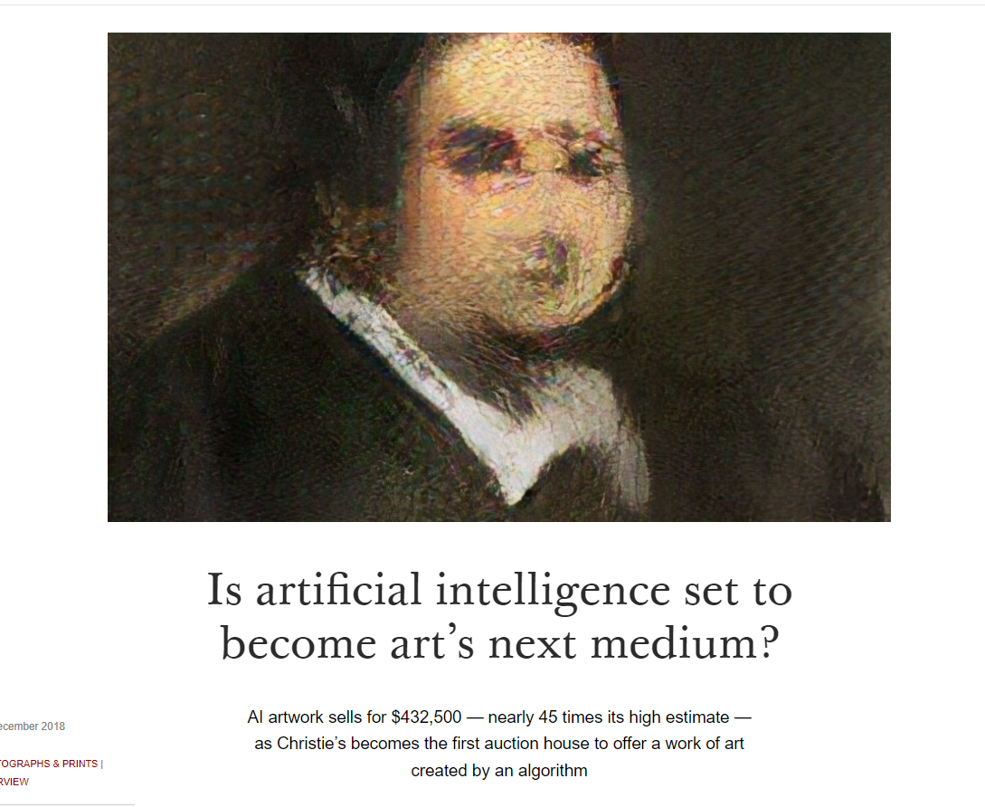
Business Application
https://www.christies.com/features/A-collaboration-between-two-artists-one-human-one-a-machine-9332-1.aspx
University of Toronto – SCS 3546 DEEP LEARNING

Slide 18
Style Transfer
THANK YOU
University of Toronto – SCS 3546 DEEP LEARNING

